Slide 1
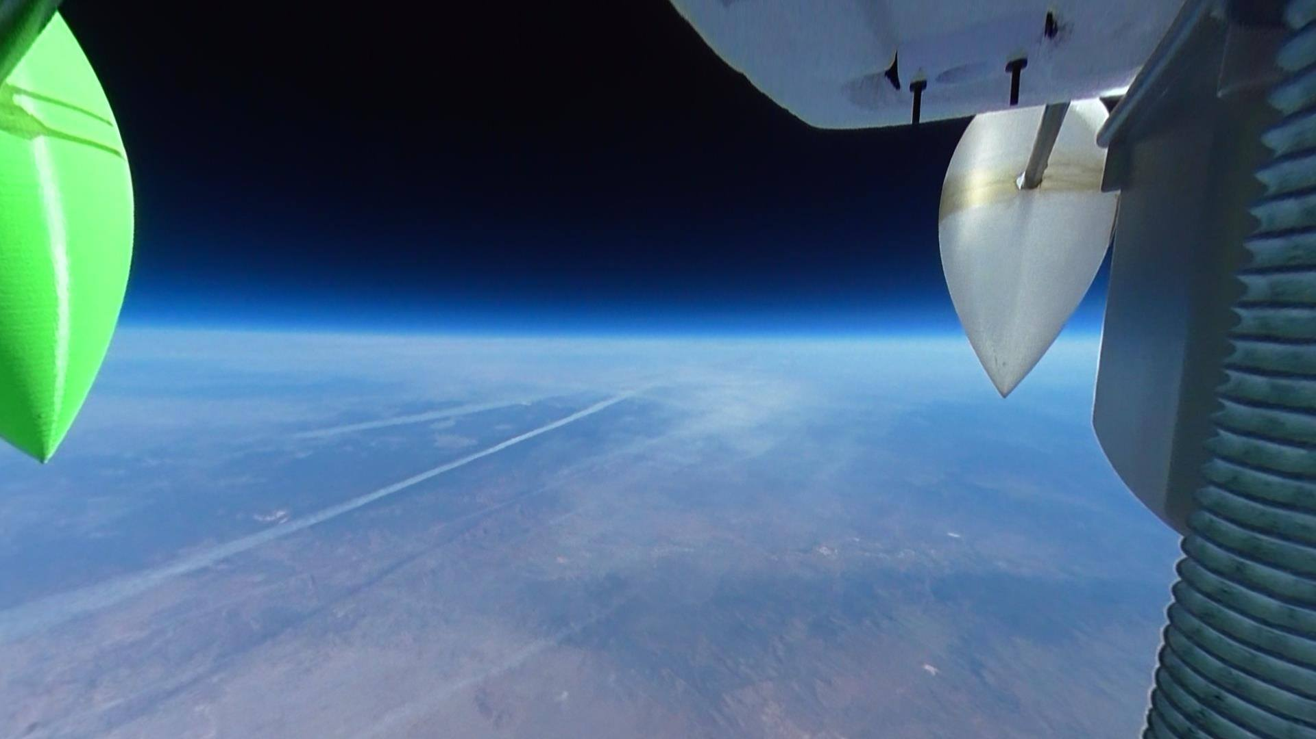

High Altitude Balloon Controlled Ascent System
(HABCAS)
By: Xander Pickard, Michael Fusco, Eric Malmquist, Austin Macosky, Daniel Cullen​
Faculty Mentor – Dr. Douglas Isenberg

Slide 2
OUTLINE
Purpose
Objectives
System
ASCEND Flights
Future Plans
Questions

Slide 3
PURPOSE

Slide 4
PURPOSE
Maintain altitude of balloon by achieving neutral buoyancy
Provides window for testing systems or conducting experiments at a specific altitude over a period of time

Slide 5
OBJECTIVES

Slide 6
PROJECT OBJECTIVES
Create a system that will release gas from high-altitude balloon in a controlled manner to achieve neutral buoyancy
Terminate flight after specified time once the balloon achieves neutral buoyancy, or at any other point in time
Create valve stem that is compatible with multiple sizes of balloons to operate system

Slide 7
SYSTEM

Slide 8
PAYLOAD BREAKDOWN
HABCAS V .1
Flight Termination
Actuator
Radio
Control System
Sensors
Mathematical Model
Tracking
Relay
GPS
APRS
Atmospheric Pressure
Internal Pressure
Ball Valve
External Temperature
Pi Cam

Slide 9
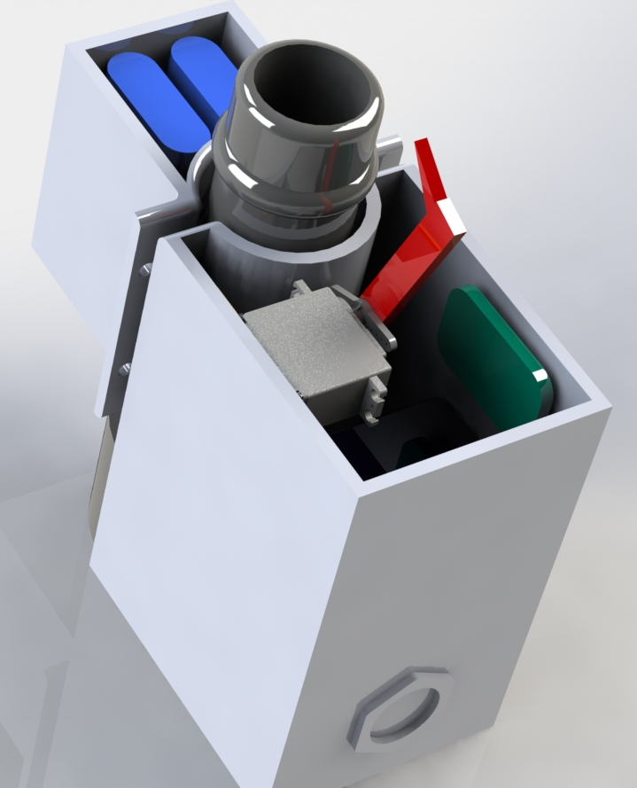
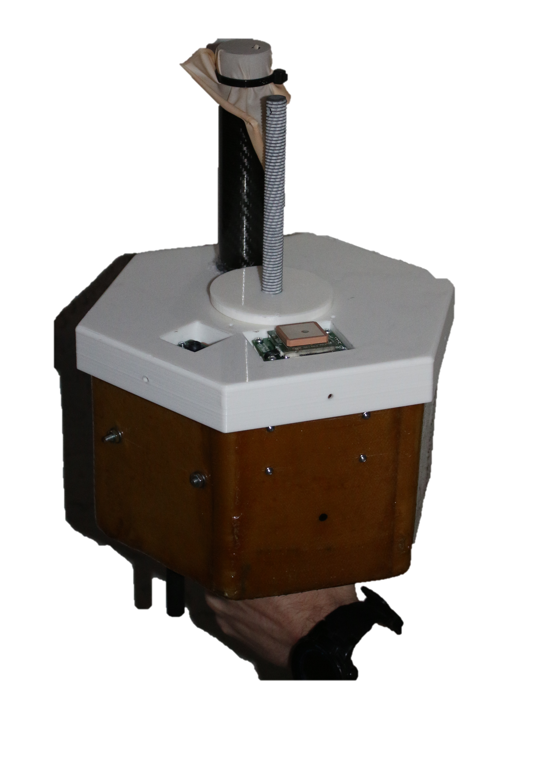
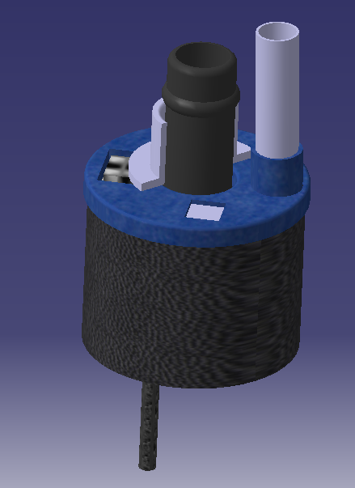
DESIGN ITERATIONS

Slide 10
SYSTEM – MECHANICAL DESIGN
Valve stem of balloon will sit inside fiber-glassed, foam–core payload housing
Gas fill valve sticks out the side
Ball valve is attached underneath the housing, into the base of the stem
Termination actuator is enclosed in a tube for safety

Slide 11
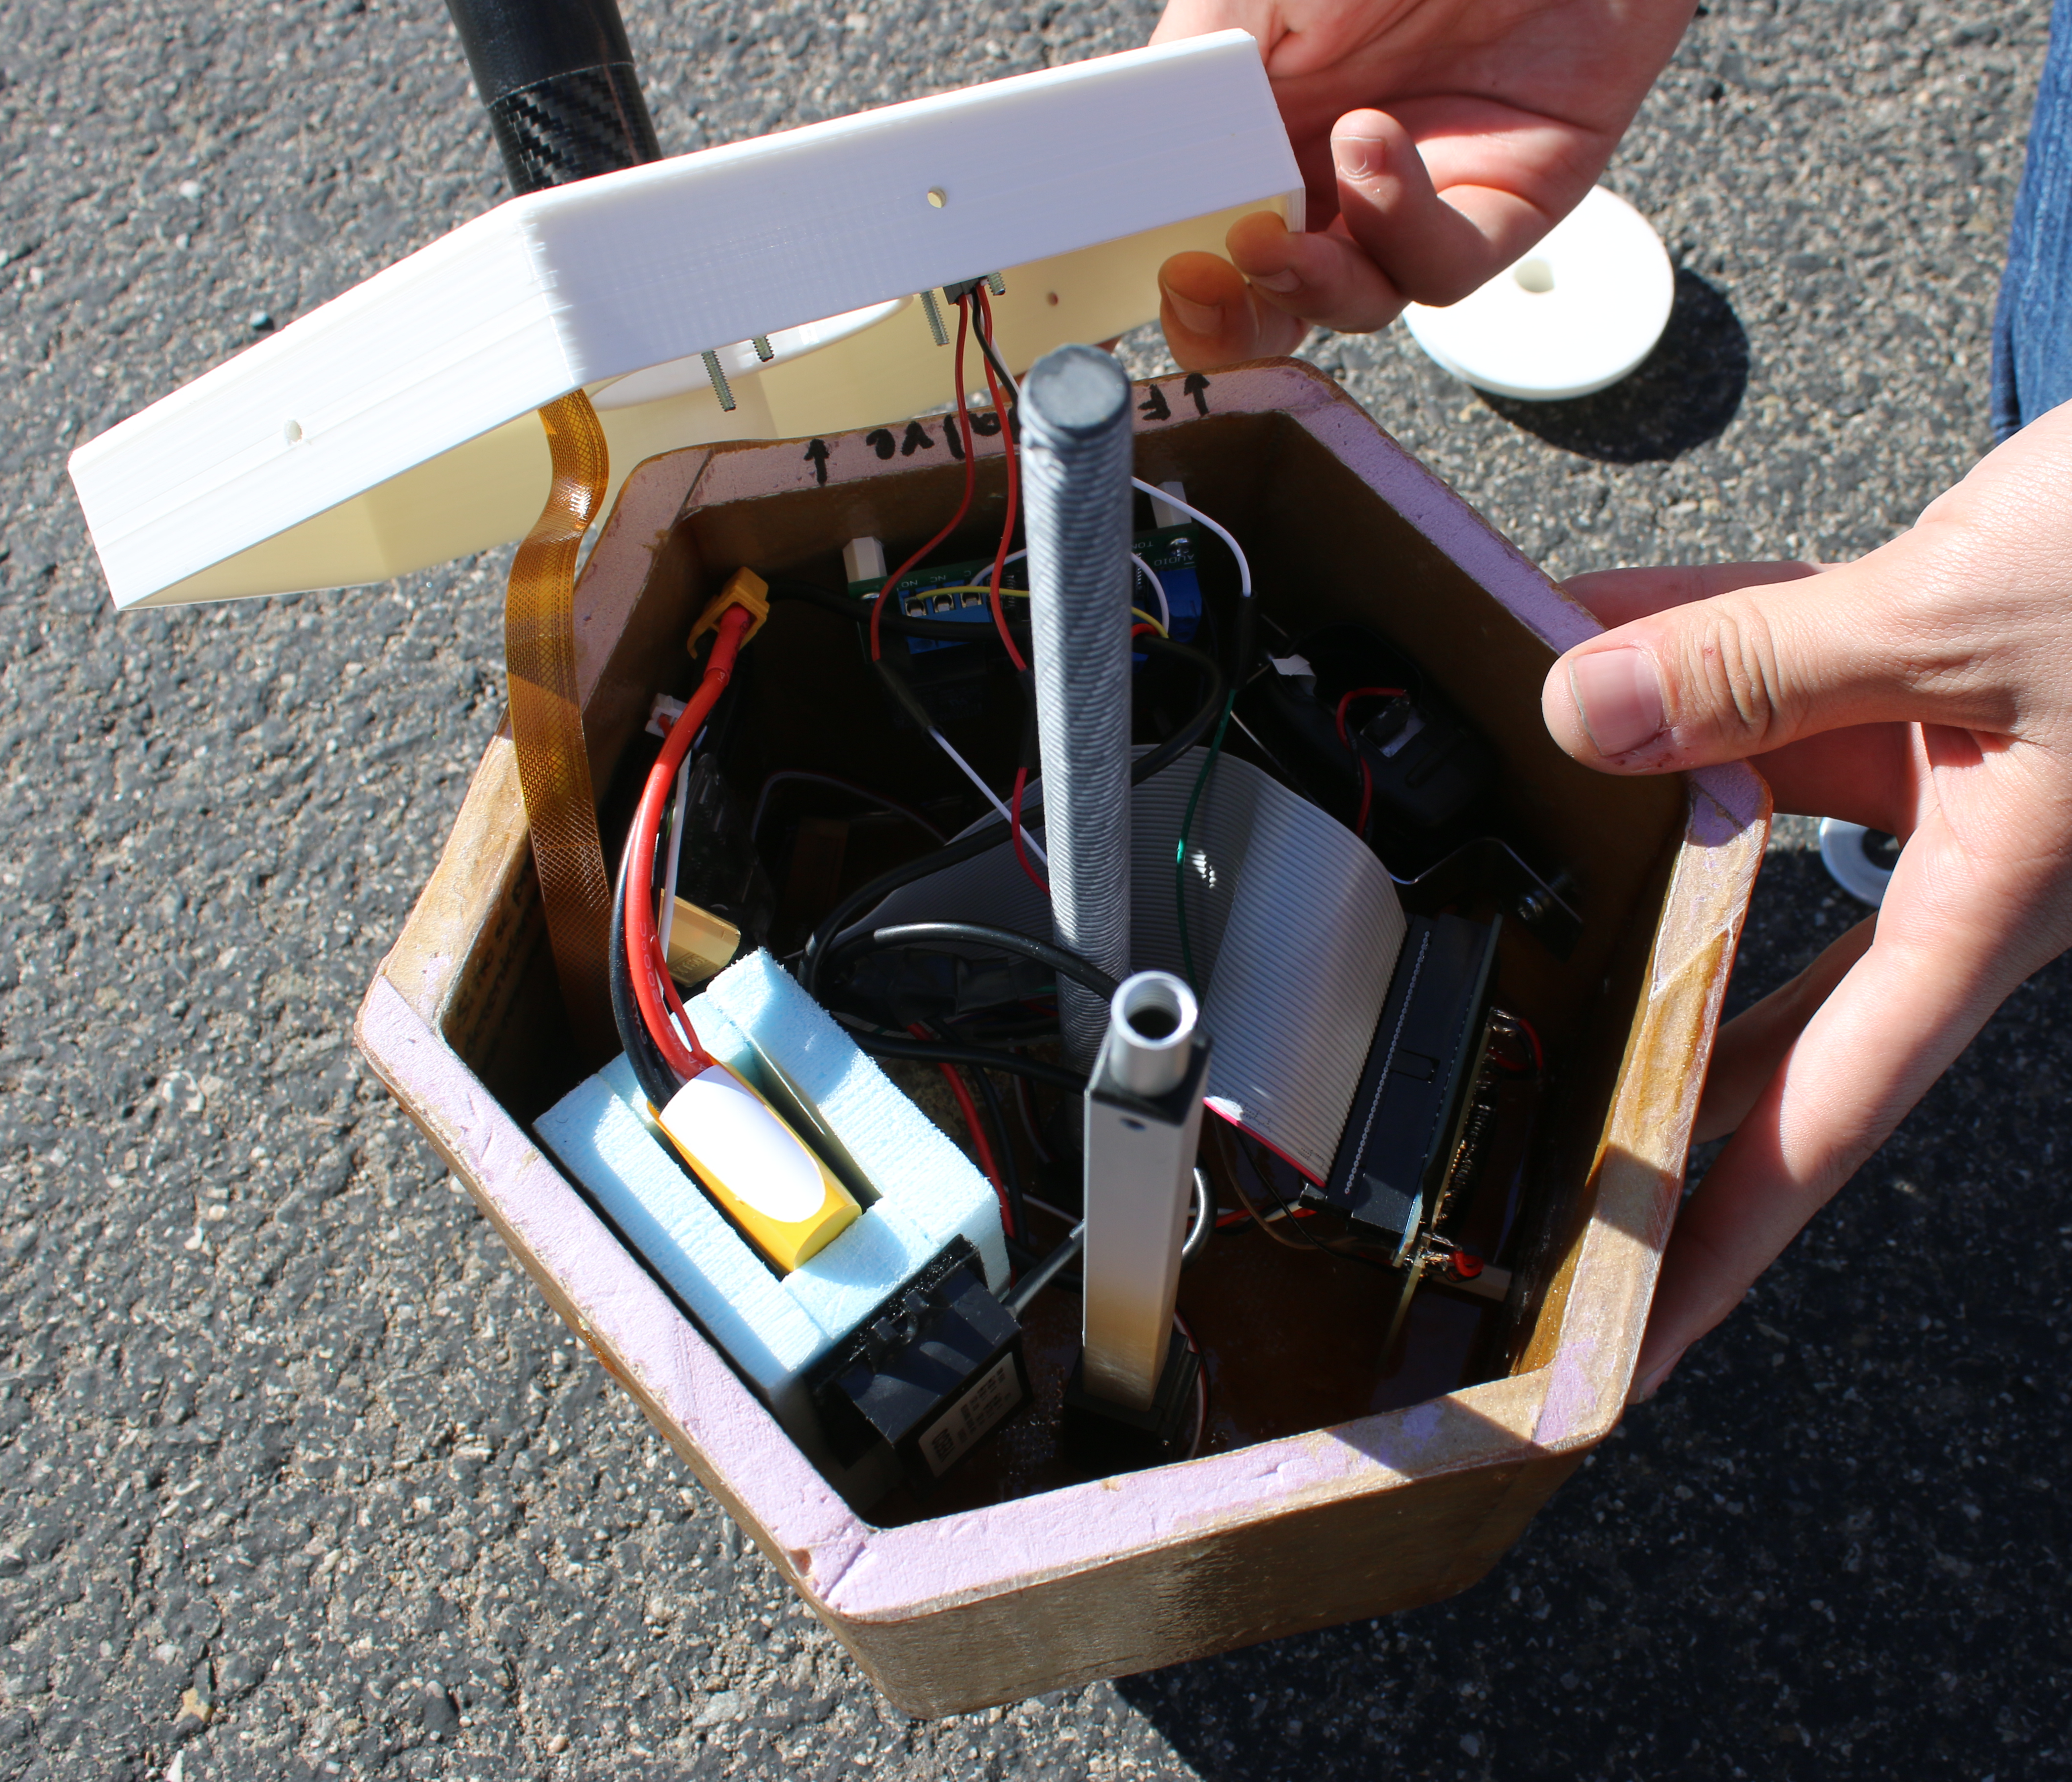
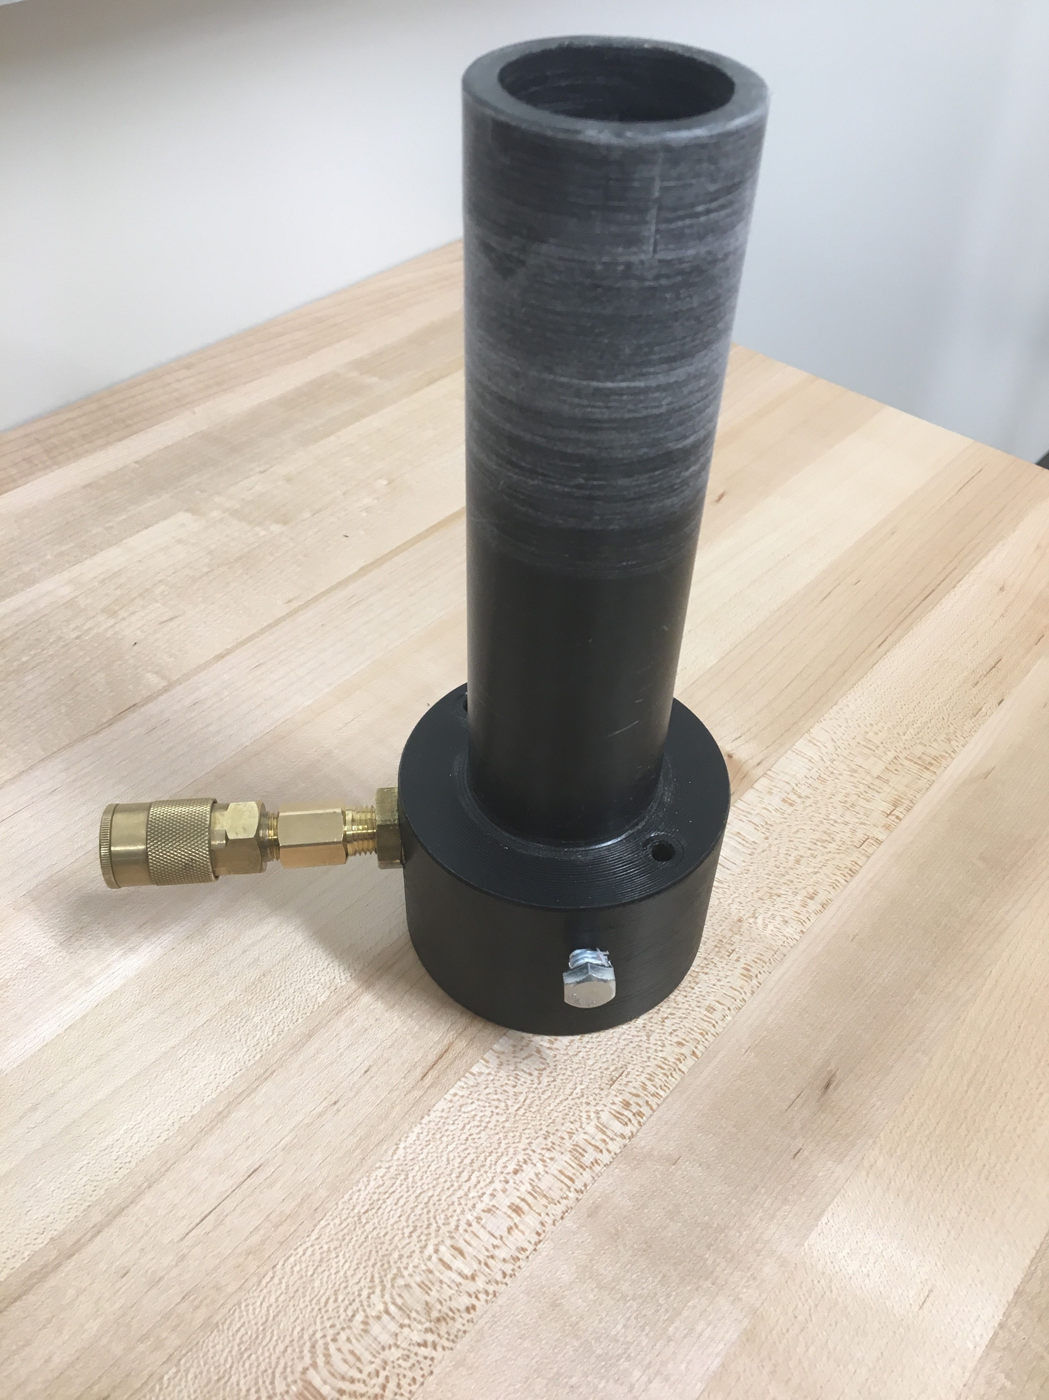
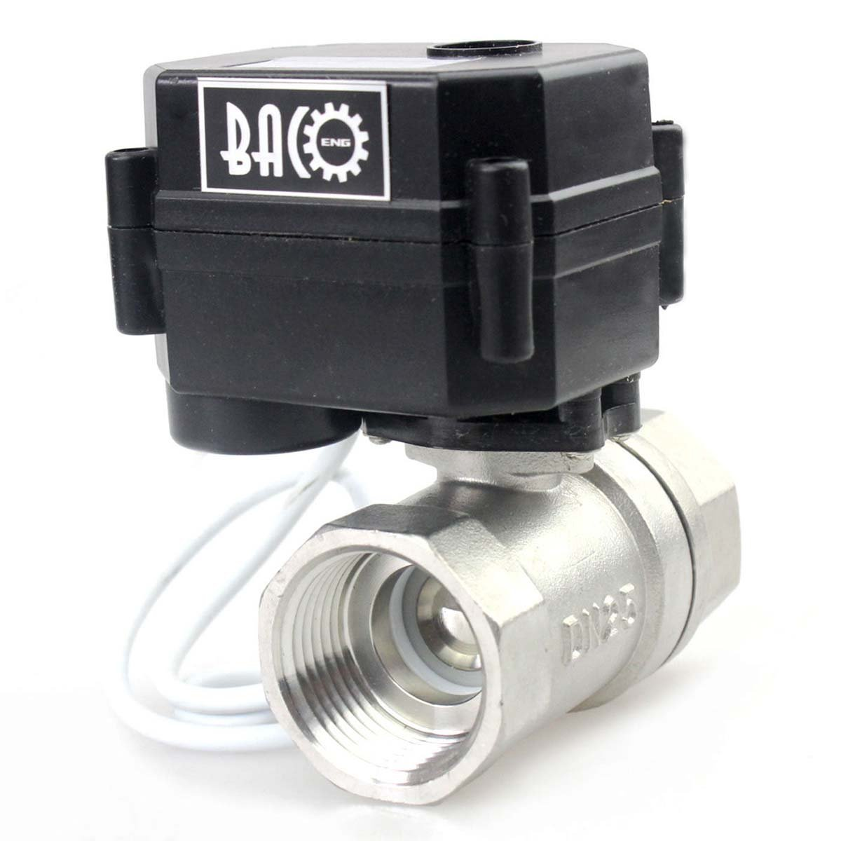
SYSTEM – MECHANICAL DESIGN

Slide 12
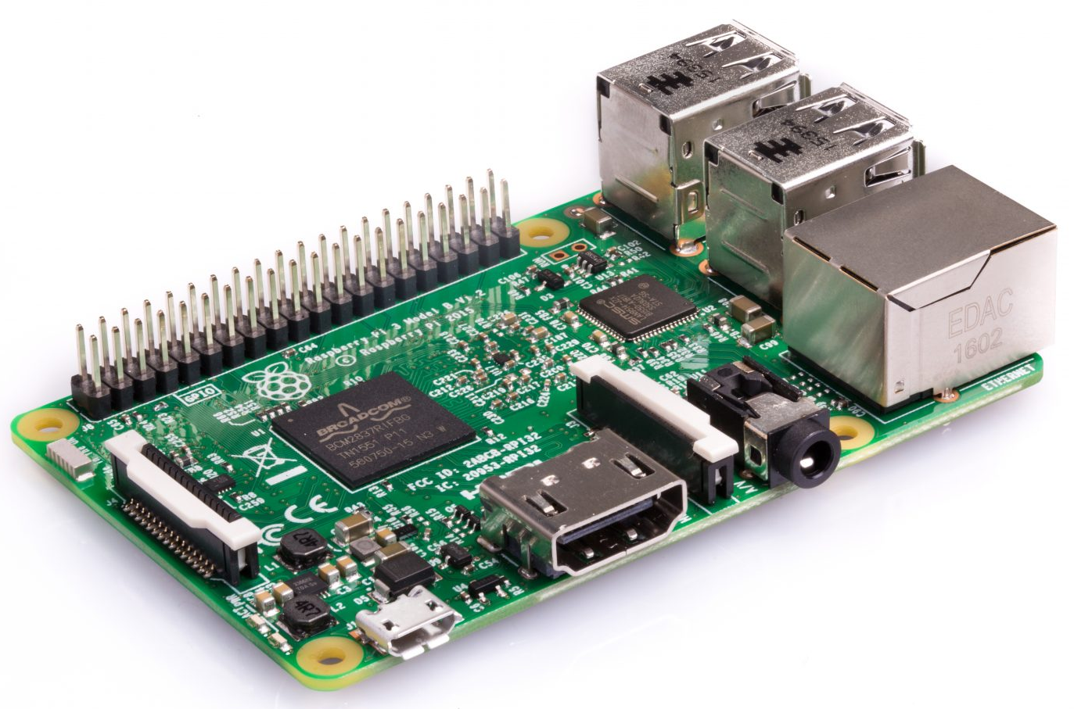
SYSTEM – CONTROLLER
Raspberry Pi 3 microcontroller
Sensors include atmospheric and internal balloon pressure, along with external temperature
GPS gathers position and velocity data
Pi-Cam records video of termination actuator and balloon

Slide 13
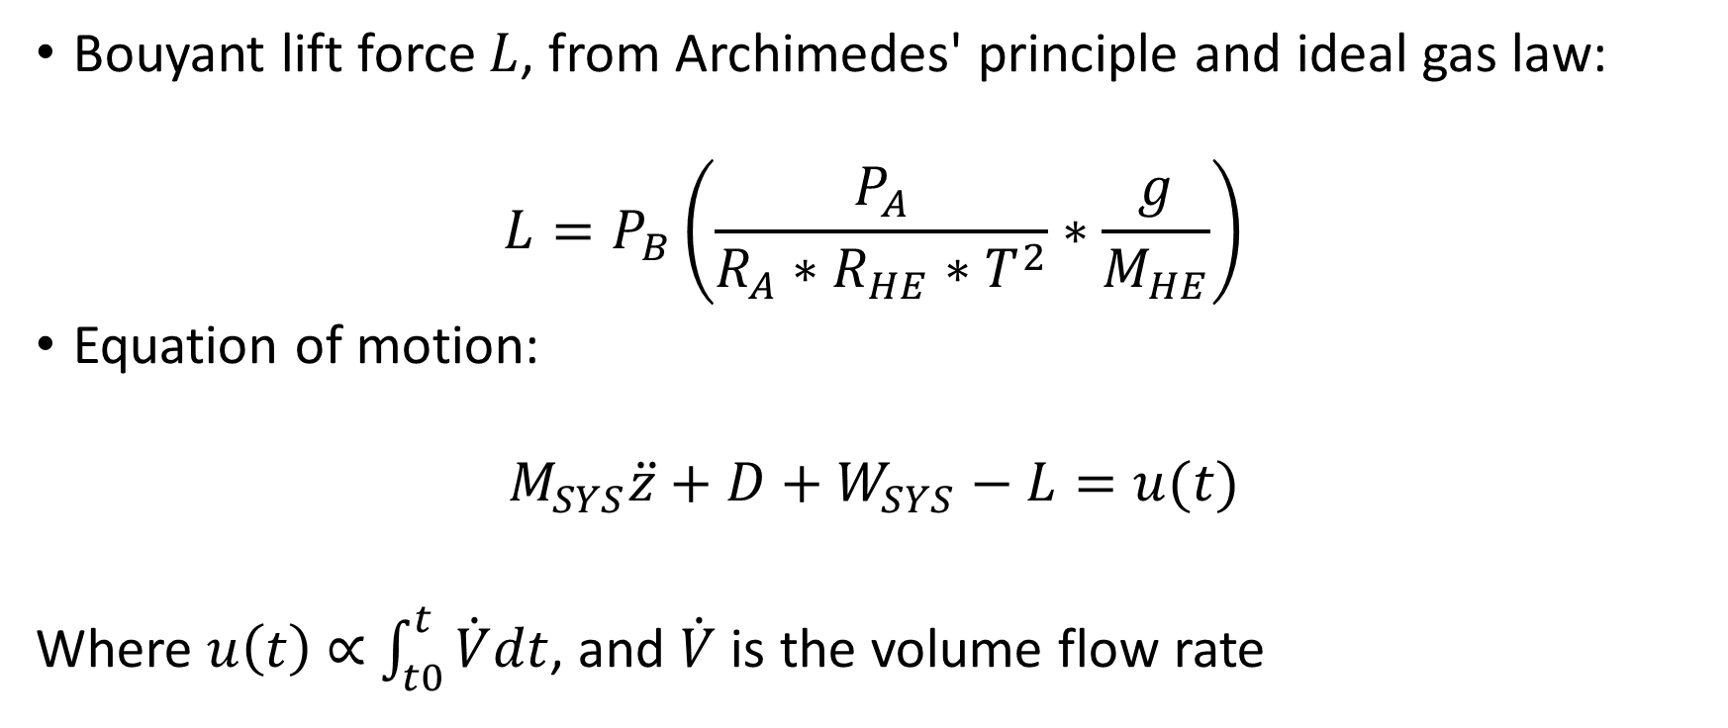
SYSTEM – DYNAMICS
Bouyant lift force $L$, from Archimedes' principle and ideal gas law:
$${L=P}_{B}\left(\frac{P_{A}}{R_{A}∗R_{HE}∗T^{2}}∗\frac{g}{M_{HE}}\right)$$
Equation of motion:
$$M_{SYS}\ddot{z}+D+W_{SYS}−L=u(t)$$
Where $u\left(t\right)\text{ ∝}$ $\int_{t0}^{t}{\dot{V}dt}$, and $\dot{V}$ is the volume flow rate

Slide 14
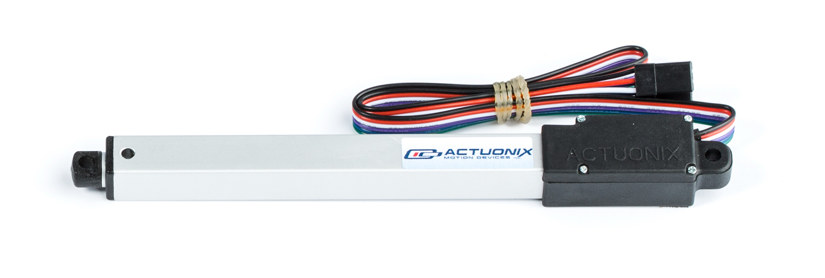
SYSTEM - TERMINATION
Actuator extends a blade into the balloon for artificial burst
Signal sent through radio tone

Slide 15
ASCEND FLIGHTS

Slide 16
11/18/17 FLIGHT OBJECTIVES
Test equipment in environment (low pressure and temperature) in a payload box (i.e., not on stem)
Activate ball valve at 60,000 ft
Close ball valve at 70,000 ft
Activate test servo 15 s after ball valve closes
Confirm results with data logger and Raspberry Pi camera

Slide 17
11/18/17 FLIGHT OUTCOME
All hardware functioned as planned, with a caveat
Valve opened at 60,000ft
Balloon burst around 68,000ft
Valve was still open on the ground
System still functioning

Slide 18
3/3/18 FLIGHT OBJECTIVES
Test flight termination sub-system to gain confidence for future flights when the control system is used
Activate termination actuator via radio command when balloon is at 50k ft, 70k ft and 90k ft during ascent and 25k ft during descent
Test equipment in environment (low pressure and temperature) in the new payload housing
Confirm results with data logger and seal over actuator

Slide 19
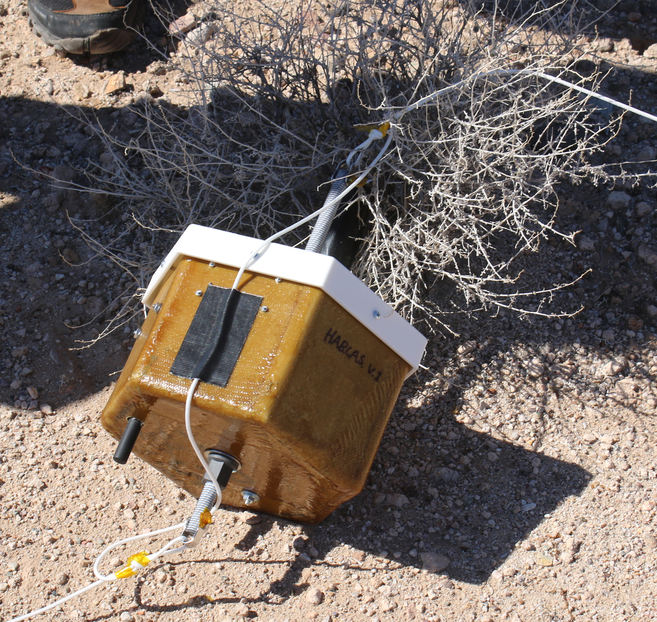
3/3/18 FLIGHT OUTCOME
Three of four cut-down commands were received
  Gives us knowledge of cut-down range
Software and seal show the cutdown did function
System and housing performed as they should have

Slide 20
FUTURE PLANS

Slide 21


Future flights
Mid-April:
  Fly complete system to test cut-down on balloon and collect both external and internal pressure data to compare against model.
  No control of altitude.
  Possibly fly test payload from Eagle Space Flight Team.
Fall 2018:
  Fly completely integrated system, including gas release and flight termination.
  Possibly along with EagleSat II test payload.

Slide 22
WHAT’S NEXT?
Run more comprehensive tests
Cut down on weight and size
Design payloads to collect long-duration data

Slide 23


THANK YOU
Arizona Space Grant Consortium
Arizona Near Space Research
Dr. Douglas Isenberg – Advisor
Dr. Gary Yale – Space Grant Representative
Jeff Hiatt – Machinist

Slide 24
QUESTIONS?
Xander Pickard
PICKARDX@my.erau.edu
Michael Fusco
  FUSCOM@my.erau.edu
Austin Macosky
  MACOSKYA@my.erau.edu
  Eric Malmquist
  MALMQUIE@my.erau.edu
  Daniel Cullen
  CULLEND@my.erau.edu

